Slide 1
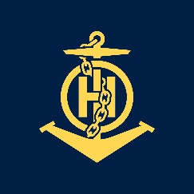
CHART PROJECT 8th Course in Marine Cartography and Data Assessment UKHO, Taunton, UK (2016)
IHO – NIPPON FOUNDATION
ALUMNI SEMINAR
MARK NEIL DEMETRIO A. QUODALA
Philippines

Slide 2
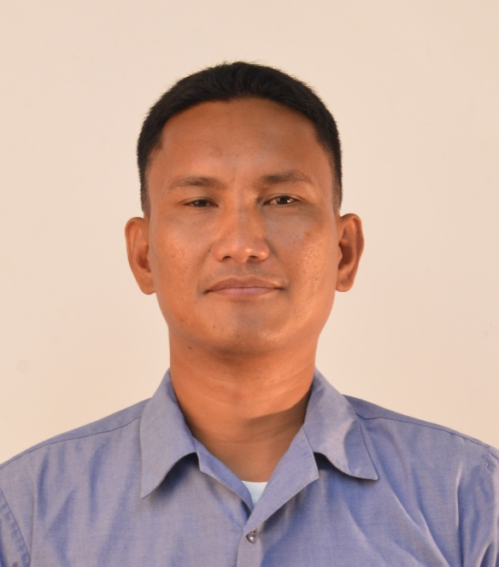
Self introduction
IHO – NIPPON FOUNDATION
ALUMNI SEMINAR
Name | MARK NEIL DEMETRIO A. QUODALA
Alumni year | 2016
Country | PHILIPPINES
Organization | NATIONAL MAPPING AND RESOURCE INFORMATION AUTHORITY (NAMRIA)
Position/Job title | SEAMAN FIRST CLASS
Current job description | CHART COMPILIER AND VERIFIER
Please put your photo here!

Slide 3
My career path and projects / Achievements
IHO – NIPPON FOUNDATION
ALUMNI SEMINAR
YEAR | POSITION | PROJECTS/ACHIEVEMENTS
2017 | COMPILIER | Chart 1526,1528,1529 and 1555
 |  | New compilation, Chart planning, Gathering Topographic and Navigational Information for updating, Bathymetric Data Compilation, Gathering Tidal Information and Compass Rose for updating, Cartographic enhancement, Quality Assurance and Printing of Charts

Slide 4
My career path and projects / Achievements
IHO – NIPPON FOUNDATION
ALUMNI SEMINAR
YEAR | POSITION | PROJECTS/ACHIEVEMENTS
2018 | COMPILIER | PH4SNJCO
 |  | New ENC compilation using ArcGis software, Gathered relevant data's and information to compile the PH4SNJCO, Quality Assurance, Run validation using ENC Designer, ENC Analyzer, Orca Master, Creation of ENC Exchange Set,

Slide 5
My career path and projects / Achievements
IHO – NIPPON FOUNDATION
ALUMNI SEMINAR
YEAR | POSITION | PROJECTS/ACHIEVEMENTS
2018 | COMPILIER | Chart 4464
 |  | New compilation using ArcGIS, Gathering Topographic and Navigational Information for updating, Gathering Tidal Information and Compass Rose for updating, Cartographic enhancement, Quality Assurance and Printing of Charts

Slide 6
My career path and projects / Achievements
IHO – NIPPON FOUNDATION
ALUMNI SEMINAR
YEAR | POSITION | PROJECTS/ACHIEVEMENTS
2018 | COMPILIER
 |  | Published Chart 1523, Chart 1528 and Chart 4659 Resource person and presented power point about Nautical Charting and ENC for the Philippine Coast Guard Execute Field Validation of ENC Exchange Set of PH5TBN40 and PH5JAGNA

Slide 7
My career path and projects / Achievements
IHO – NIPPON FOUNDATION
ALUMNI SEMINAR
YEAR | POSITION | PROJECTS/ACHIEVEMENTS
2019 | COMPILIER / VERIFIER | Chart 1531, Chart 1521, Chart 1533, Chart 1559, Chart 1527, Chart 1536, Chart 1549, Chart 1557, Chart 1512, Chart 1508, Chart 1563, Chart 1539, Chart 1526, Chart 1564
 |  | Verified Charts all relevant to Topography and Hydrography Resource person and presented power point about Nautical Charting for the Philippine Coast Guard

Slide 8
My career path and projects / Achievements
IHO – NIPPON FOUNDATION
ALUMNI SEMINAR
YEAR | POSITION | PROJECTS/ACHIEVEMENTS
2019 | COMPILIER | Chart 2200 (Overview Chart)
 |  | Research work, Chart planning, Gathering Topographic and Navigational Information for updating, Bathymetric Data Compilation, Gathering Tidal Information and Compass Rose for updating, Cartographic enhancement, Quality Assurance and Printing of Charts

Slide 9
Lessons learned from CHART Course
IHO – NIPPON FOUNDATION
ALUMNI SEMINAR
FOUNDATION
Geodesy
Projections
Chart Orders
Latitude and Longitude
Bearing and Distance
Chart Datum
Source Diagram
Chart Design
Chart Title
Chart Symbol and Abbreviation
Chart Text
Hydrography

Slide 10
Lessons learned from CHART Course
IHO – NIPPON FOUNDATION
ALUMNI SEMINAR
FOUNDATION
Depths Contours
Depth Selection
Nature of the Seabed
Tides Theory
Vertical Datum
Wrecks
Navigational Dangers
Aids to Navigation
Sailing Direction
Navigational Buoys – the IALA System
Magnetics
Topography

Slide 11
Lessons learned from CHART Course
IHO – NIPPON FOUNDATION
ALUMNI SEMINAR
COMPILATION
Understanding IHO S-57 Transfer Standard
Overview of S-57
ENC Product Specification
Introduction to Objects and Attributes
Introduction to Topology
Object and Attributes Catalogue
Mandatory Attributes
META Objects
Master Slave Relationship
Encoding Rocks, Wrecks, Obstns and Seabed
CATZOC and M_SREL

Slide 12
Lessons learned from CHART Course
IHO – NIPPON FOUNDATION
ALUMNI SEMINAR
COMPILATION
ENC Production Software – CARIS familiarisation
Introduction to ENC Software
Data Capture
Lights and Light Supports, Light Sectors
Capturing Navigational Lines
Encoding Chart Notes and Picture Files
Encoding Magnetic Variation
S-57 Theory Test

Slide 13
Lessons learned from CHART Course
IHO – NIPPON FOUNDATION
ALUMNI SEMINAR
COMPILATION
Data Base Compilation
Create New Cell
Coastline Compilation
Bathymetry Compilation
Geometry and S-58 Tests
Topography
Genaralisation of data

Slide 14
Lessons learned from CHART Course
IHO – NIPPON FOUNDATION
ALUMNI SEMINAR
PRODUCT CONSTRUCTION
Enc Production
Navigational Purpose (Usage Bands)
Cell Size
Topology
Object Classes and Attributes
Polygons Language
Cartographic Framework

Slide 15
Lessons learned from CHART Course
IHO – NIPPON FOUNDATION
ALUMNI SEMINAR
PRODUCT CONSTRUCTION
PAPER CHART
Chart Design
Title Notes
Cautionary Notes
Tidal Information
Text Placement
Magnetic Compasses
Source Diagrams

Slide 16
Lessons learned from CHART Course
IHO – NIPPON FOUNDATION
ALUMNI SEMINAR
DATA ASSESSMENT AND PRODUCT MAINTENANCE
Source Data
Data Assessment
Textual
Charts Maps
Surveys
Notice to Mariners
Notice to Mariners Blocks
ENC Updates
New Edition

Slide 17
Lessons learned from CHART Course
IHO – NIPPON FOUNDATION
ALUMNI SEMINAR
FINAL PROJECT
BRIXAM PROJECT

Slide 18
Suggestion for the future
IHO – NIPPON FOUNDATION
ALUMNI SEMINAR
Continue the CHART PROJECT program in order for the new cartographers to cope up with changes and updates in the field of marine cartography.

Slide 19
THANK YOU
IHO – NIPPON FOUNDATION
ALUMNI SEMINAR

